Slide 1
IOT BASED ACCURATE THERMAL SCREENING AND ALERT FOR COVID SITUATION USING BEAGLEBONE

Slide 2
Content
Introduction
Interfacing buzzer (speaker) with Beagle bone black
Speaker specifications
Hardware Wiring

Slide 3
Cont…
Connections
Coding
References

Slide 4
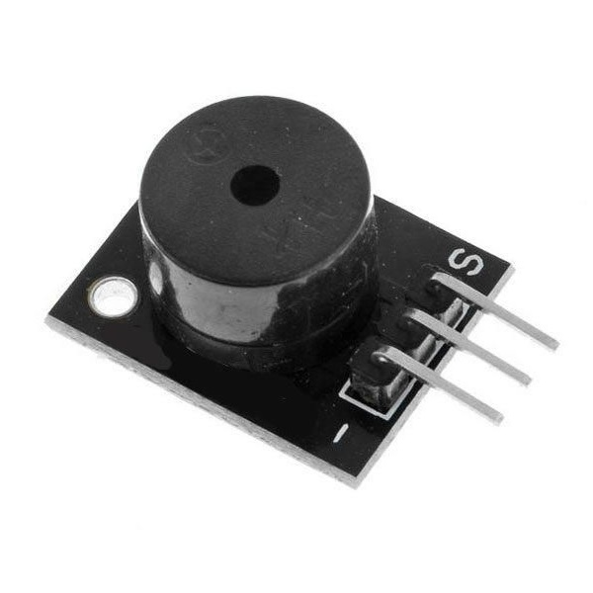
Introduction
In our project design we are using a speaker which creates an audible sound to give an alert whenever the temperature is higher than the ambient temperature.

Slide 5
Cont…..
We are using a small PCB Mountable 5V Passive Buzzer.
It is great to add Audio Alert to our electronic design.
The speaker operates on 5V supply.
The speaker uses a coil element to generate an audible tone.

Slide 6
Speaker Specifications
The maximum input voltage of the speaker is 5V.
The resistance of the speaker is 42ohms.
Resonance frequency is 2048Hz.

Slide 7
Cont….
The pin pitch of the speaker is 6mm.
It is available in the market for a low cost, therefore it is affordable.
This speaker is available in small size.

Slide 8
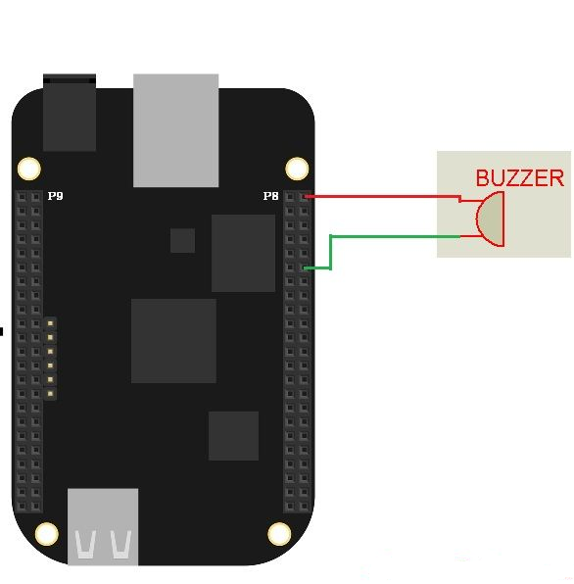
Hardware Wiring

Slide 9
Connection details
Interfacing the speaker to Beagle bone black is the easiest task in our project.
The connections are very simple, the speaker has two pins
One pin is connected to Beagle bone’s pin number P8.12
The other pin is connected to the ground.

Slide 10
Coding
#include <iobb.h> // Library to access GPIO
#include <stdio.h> // Standard IO library
int main(void)
{
iolib_init(); //Initializing the iobb library
iolib_setdir(8, 12, DigitalOut); //Setting Pin as Output of a specific port
while(1) // Infinite Loop
{
pin_high(8, 12); // Making the connected pin high
printf("BUZZER ON \n"); // Message Print

Slide 11
Cont….
iolib_delay_ms(500); //A delay of 500 ms
pin_low(8, 12); // Making the connected pin low
printf("BUZZER OFF \n"); // Message Print
iolib_delay_ms(500); //A delay of 500 ms
}
iolib_free(); //Free up all the GPIOs
return(0); //End of Main Function
}

Slide 12
References
Components101. (2020, March 31). MLX90614 Non-Contact IR Temperature Sensor Pin out, Datasheet, Equivalents & Specs. https://components101.com/sensors/melexis-mlx90614-contact-less-ir-temperature-sensor
BeagleBoard.org. (2019, September 6). BeagleBoard.org - black. Retrieved June 5, 2020, from https://beagleboard.org/black
M. D. Dramićanin, Z. Antić, S. Kuzman and T. Thundat, "Contactless temperature sensing via luminescence," 2016 18th International Conference on Transparent Optical Networks (ICTON), Trento, 2016, pp. 1-1, doi: 10.1109/ICTON.2016.7550592. https://ieeexplore.ieee.o
https://robu.in/product/5v-passive-buzzer/?gclid=CjwKCAjwsO_4BRBBEiwAyagRTS9M9Vdsn3sjUHJkOa5Zat2hPbe3-KKWSj841250KvXfav0SW1W7IxoC9FUQAvD_BwE

